Slide 1
Graphs
1843
ORD
SFO
802
337
1743
LAX
1233
DFW

Slide 2
Outline and Reading
Review
  Adjacency matrix structure (§6.2.3)
  Kruskal’s MST algorithm (§7.3.1)
Partition ADT and implementation (§4.2.2)
The decorator pattern (§6.5.1)
The traveling salesperson problem
  Definition
  Approximation algorithm (§13.4.3)

Slide 3
Graph Assignment
Goals
  Learn and implement the adjacency matrix structure an Kruskal’s minimum spanning tree algorithm
  Understand and use the decorator pattern and various JDSL classes and interfaces
Your task
  Implement the adjacency matrix structure for representing a graph
  Implement Kruskal’s MST algorithm
Frontend
  Computation and visualization of an approximate traveling salesperson tour

Slide 4
Adjacency Matrix Structure
Edge list structure
Augmented vertex objects
  Integer key (index) associated with vertex
2D-array adjacency array
  Reference to edge object for adjacent vertices
  Null for non nonadjacent vertices
a
v
b
u
w
0
u
1
v
2
w
 | 0 | 1 | 2
0 | ∅ |  | ∅
1 |  | ∅
2 | ∅ |  | ∅
a
b

Slide 5
Kruskal’s Algorithm
The vertices are partitioned into clouds
  We start with one cloud per vertex
  Clouds are merged during the execution of the algorithm
Partition ADT:
  makeSet(o): create set {o} and return a locator for object o
  find(l): return the set of the object with locator l
  union(A,B): merge sets A and B
Algorithm KruskalMSF(G)
Input weighted graph G
Output labeling of the edges of a
minimum spanning forest of G
Q ← new heap-based priority queue
for all v ∈ G.vertices() do
l ← makeSet(v) { elementary cloud }
setLocator(v,l)
for all e ∈ G.edges() do
Q.insert(weight(e), e)
  while ¬Q.isEmpty()
  e ← Q.removeMin()
[u,v] ← G.endVertices(e)
A ← find(getLocator(u))
B ← find(getLocator(v))
if A ≠ B
setMSFedge(e)
{ merge clouds }
union(A, B)

Slide 6
Example
G
G
B
8
8
4
B
4
9
E
6
9
E
6
1
5
F
1
5
F
C
11
3
C
11
3
2
2
7
D
H
7
H
A
D
10
A
10
G
G
B
8
B
8
4
4
9
E
6
9
E
6
1
5
F
1
5
F
C
11
3
C
11
3
2
2
7
D
H
7
H
D
A
10
A
10

Slide 7
Example (contd.)
G
G
B
8
8
4
B
4
9
E
6
9
E
6
1
5
F
1
5
F
C
11
3
C
11
3
2
2
7
D
H
7
H
D
A
10
A
10
four steps
two steps
G
G
B
8
B
8
4
4
9
E
6
9
E
6
1
5
F
1
5
F
C
11
3
C
11
3
2
2
7
D
H
7
D
H
A
10
A
10

Slide 8
Partition Implementation
Partition implementation
  A set is represented the sequence of its elements
  A position stores a reference back to the sequence itself (for operation find)
  The position of an element in the sequence serves as locator for the element in the set
  In operation union, we move the elements of the smaller sequence into to the larger sequence
Worst-case running times
  makeSet, find: O(1)
  union: O(min(n_{A}, n_{B}))
Amortized analysis
  Consider a series of k Partiton ADT operations that includes n makeSet operations
  Each time we move an element into a new sequence, the size of its set at least doubles
  An element is moved at most log₂ n times
  Moving an element takes O(1) time
  The total time for the series of operations is O(k + n log n)

Slide 9
Analysis of Kruskal’s Algorithm
Graph operations
  Methods vertices and edges are called once
  Method endVertices is called m times
Priority queue operations
  We perform m insert operations and m removeMin operations
Partition operations
  We perform n makeSet operations, 2m find operations and no more than n − 1 union operations
Label operations
  We set vertex labels n times and get them 2m times
Kruskal’s algorithm runs in time O((n + m) log n) time provided the graph has no parallel edges and is represented by the adjacency list structure

Slide 10
Decorator Pattern
Labels are commonly used in graph algorithms
  Auxiliary data
  Output
Examples
  DFS: unexplored/visited label for vertices and unexplored/ forward/back labels for edges
  Dijkstra and Prim-Jarnik: distance, locator, and parent labels for vertices
  Kruskal: locator label for vertices and MSF label for edges
The decorator pattern extends the methods of the Position ADT to support the handling of attributes (labels)
  has(a): tests whether the position has attribute a
  get(a): returns the value of attribute a
  set(a, x): sets to x the value of attribute a
  destroy(a): removes attribute a and its associated value (for cleanup purposes)
The decorator pattern can be implemented by storing a dictionary of (attribute, value) items at each position

Slide 11
Traveling Salesperson Problem
A tour of a graph is a spanning cycle (e.g., a cycle that goes through all the vertices)
A traveling salesperson tour of a weighted graph is a tour that is simple (i.e., no repeated vertices or edges) and has has minimum weight
No polynomial-time algorithms are known for computing traveling salesperson tours
The traveling salesperson problem (TSP) is a major open problem in computer science
  Find a polynomial-time algorithm computing a traveling salesperson tour or prove that none exists
7
D
B
4
2
2
5
F
C
8
6
3
E
A
1
Example of traveling
salesperson tour
(with weight 17)

Slide 12
TSP Approximation
We can approximate a TSP tour with a tour of at most twice the weight for the case of Euclidean graphs
  Vertices are points in the plane
  Every pair of vertices is connected by an edge
  The weight of an edge is the length of the segment joining the points
Approximation algorithm
  Compute a minimum spanning tree
  Form an Eulerian circuit around the MST
  Transform the circuit into a tour

Slide 13
Outline and Reading
Graphs (§6.1)
  Definition
  Applications
  Terminology
  Properties
  ADT
Data structures for graphs (§6.2)
  Edge list structure
  Adjacency list structure
  Adjacency matrix structure

Slide 14
Graph
A graph is a pair (V, E), where
  V is a set of nodes, called vertices
  E is a collection of pairs of vertices, called edges
  Vertices and edges are positions and store elements
Example:
  A vertex represents an airport and stores the three-letter airport code
  An edge represents a flight route between two airports and stores the mileage of the route
849
PVD
1843
ORD
142
SFO
802
LGA
337
1743
1387
HNL
2555
1099
LAX
1233
DFW
1120
MIA

Slide 15
Edge Types
Directed edge
  ordered pair of vertices (u,v)
  first vertex u is the origin
  second vertex v is the destination
  e.g., a flight
Undirected edge
  unordered pair of vertices (u,v)
  e.g., a flight route
Directed graph
  all the edges are directed
  e.g., route network
Undirected graph
  all the edges are undirected
  e.g., flight network
flight
AA 1206
ORD
PVD
849
miles
ORD
PVD

Slide 16
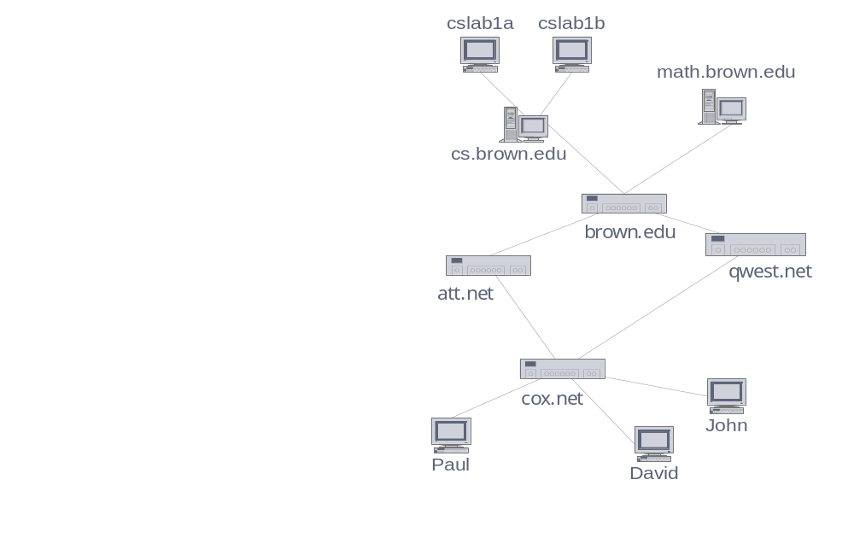
Applications
Electronic circuits
  Printed circuit board
  Integrated circuit
Transportation networks
  Highway network
  Flight network
Computer networks
  Local area network
  Internet
  Web
Databases
  Entity-relationship diagram

Slide 17
Terminology
End vertices (or endpoints) of an edge
  U and V are the endpoints of a
Edges incident on a vertex
  a, d, and b are incident on V
Adjacent vertices
  U and V are adjacent
Degree of a vertex
  X has degree 5
Parallel edges
  h and i are parallel edges
Self-loop
  j is a self-loop
V
a
b
h
j
U
d
X
Z
c
e
i
W
g
f
Y

Slide 18
Terminology (cont.)
Path
  sequence of alternating vertices and edges
  begins with a vertex
  ends with a vertex
  each edge is preceded and followed by its endpoints
Simple path
  path such that all its vertices and edges are distinct
Examples
  P₁=(V,b,X,h,Z) is a simple path
  P₂=(U,c,W,e,X,g,Y,f,W,d,V) is a path that is not simple
V
a
b
P₁
d
U
X
Z
P₂
h
c
e
W
g
f
Y

Slide 19
Terminology (cont.)
Cycle
  circular sequence of alternating vertices and edges
  each edge is preceded and followed by its endpoints
Simple cycle
  cycle such that all its vertices and edges are distinct
Examples
  C₁=(V,b,X,g,Y,f,W,c,U,a,↵) is a simple cycle
  C₂=(U,c,W,e,X,g,Y,f,W,d,V,a,↵) is a cycle that is not simple
V
a
b
d
U
X
Z
C₂
h
e
C₁
c
W
g
f
Y

Slide 20
Properties
Property 1
  Σ_{v} deg(v) = 2m
  Proof: each edge is counted twice
Property 2
  In an undirected graph with no self-loops and no multiple edges
  m ≤ n (n − 1)/2
  Proof: each vertex has degree at most (n − 1)
What is the bound for a directed graph?
Notation
  n number of vertices
  m number of edges
  deg(v) degree of vertex v
Example
  n = 4
  m = 6
  deg(v) = 3

Slide 21
Main Methods of the Graph ADT
Vertices and edges
  are positions
  store elements
Accessor methods
  aVertex()
  incidentEdges(v)
  endVertices(e)
  isDirected(e)
  origin(e)
  destination(e)
  opposite(v, e)
  areAdjacent(v, w)
Update methods
  insertVertex(o)
  insertEdge(v, w, o)
  insertDirectedEdge(v, w, o)
  removeVertex(v)
  removeEdge(e)
Generic methods
  numVertices()
  numEdges()
  vertices()
  edges()

Slide 22
Edge List Structure
Vertex object
  element
  reference to position in vertex sequence
Edge object
  element
  origin vertex object
  destination vertex object
  reference to position in edge sequence
Vertex sequence
  sequence of vertex objects
Edge sequence
  sequence of edge objects
u
a
c
b
d
v
w
z
u
v
w
z
a
b
c
d

Slide 23
Adjacency List Structure
Edge list structure
Incidence sequence for each vertex
  sequence of references to edge objects of incident edges
Augmented edge objects
  references to associated positions in incidence sequences of end vertices
a
v
b
u
w
u
v
w
a
b

Slide 24
Adjacency Matrix Structure
Edge list structure
Augmented vertex objects
  Integer key (index) associated with vertex
2D-array adjacency array
  Reference to edge object for adjacent vertices
  Null for non nonadjacent vertices
The “old fashioned” version just has 0 for no edge and 1 for edge
a
v
b
u
w
0
u
1
v
2
w
 | 0 | 1 | 2
0 | ∅ |  | ∅
1 |  | ∅
2 | ∅ |  | ∅
a
b

Slide 25
Asymptotic Performance
n vertices, m edges no parallel edges no self-loops Bounds are “big-Oh” | Edge List | Adjacency List | Adjacency Matrix
Space | n + m | n + m | n²
incidentEdges(v) | m | deg(v) | n
areAdjacent (v, w) | m | min(deg(v), deg(w)) | 1
insertVertex(o) | 1 | 1 | n²
insertEdge(v, w, o) | 1 | 1 | 1
removeVertex(v) | m | deg(v) | n²
removeEdge(e) | 1 | 1 | 1

